Slide 2
Family size | Number of affected FDR |  |  | Proportion of affected FDR
 | 0 | 1 | ≥2 | Mean | SD
Large | 808 | 77 | 15 | 0.0118 | 0.0377
Medium | 929 | 80 | 11 | 0.0159 | 0.0547
Small | 29 | 3 | 0 | 0.0313 | 0.0987

Slide 3
 | 0 | 1 | 2 | Mean | SD
0 | 1509 | 127 | 23 | 0.01259 | 0.043743
1 | 257 | 33 | 3 | 0.023789 | 0.070285
Age at onset | Number of affected FDR |  |  | Proportion of affected FDR
 | 0 | 1 | ≥2 | Mean | SD
≤ 50 | 257 | 33 | 3 | 0.023789 | 0.070285
> 50 | 1,509 | 127 | 23 | 0.01259 | 0.043743

Slide 4
FH2
Factor | Number of subjects | Covariate adjusted Hazard ratio | 95% Confidence Interval | P-value
Family history of CRC
No | 1,766 | 1.00 (ref) | - | 0.0188
Yes | 186 | 1.1998 | [1.0306 , 1.3968]
No. of affected FDRs
0 (no FH) | 1,766 | 1.00 (ref)
1 FDR | 160 | 1.2540 | [1.0657 , 1.4756] | 0.0064
≥ 2 FDR | 26 | 0.9479 | [0.9133 , 1.0948] | 0.7865

Slide 5
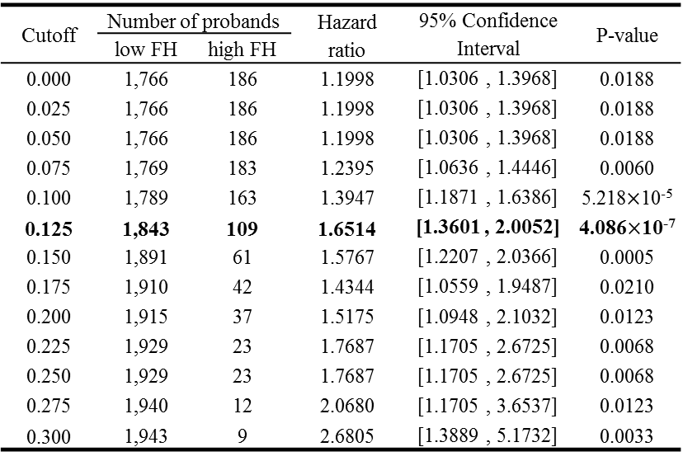
Cutoff | Number of probands |  | Hazard ratio | 95% Confidence Interval | P-value
 | low FH | high FH
0.000 | 1,766 | 186 | 1.1998 | [1.0306 , 1.3968] | 0.0188
0.025 | 1,766 | 186 | 1.1998 | [1.0306 , 1.3968] | 0.0188
0.050 | 1,766 | 186 | 1.1998 | [1.0306 , 1.3968] | 0.0188
0.075 | 1,769 | 183 | 1.2395 | [1.0636 , 1.4446] | 0.0060
0.100 | 1,789 | 163 | 1.3947 | [1.1871 , 1.6386] | 5.218$×$10⁻⁵
0.125 | 1,843 | 109 | 1.6514 | [1.3601 , 2.0052] | 4.086$×$10⁻⁷
0.150 | 1,891 | 61 | 1.5767 | [1.2207 , 2.0366] | 0.0005
0.175 | 1,910 | 42 | 1.4344 | [1.0559 , 1.9487] | 0.0210
0.200 | 1,915 | 37 | 1.5175 | [1.0948 , 2.1032] | 0.0123
0.225 | 1,929 | 23 | 1.7687 | [1.1705 , 2.6725] | 0.0068
0.250 | 1,929 | 23 | 1.7687 | [1.1705 , 2.6725] | 0.0068
0.275 | 1,940 | 12 | 2.0680 | [1.1705 , 3.6537] | 0.0123
0.300 | 1,943 | 9 | 2.6805 | [1.3889 , 5.1732] | 0.0033

Slide 6
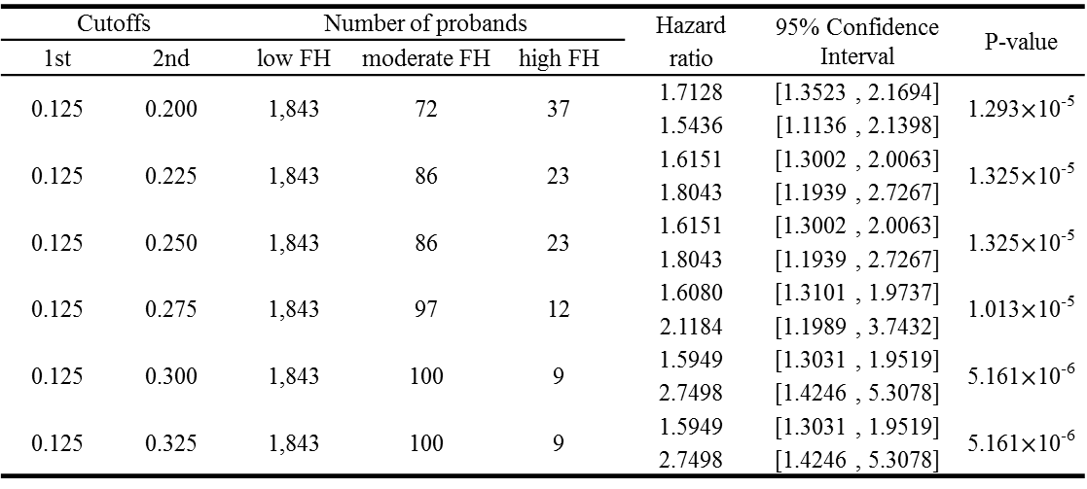
Cutoffs |  | Number of probands |  |  | Hazard ratio | 95% Confidence Interval | P-value
1st | 2nd | low FH | moderate FH | high FH
0.125 | 0.200 | 1,843 | 72 | 37 | 1.7128 | [1.3523 , 2.1694] | 1.293$×$10⁻⁵
 |  |  |  |  | 1.5436 | [1.1136 , 2.1398]
0.125 | 0.225 | 1,843 | 86 | 23 | 1.6151 | [1.3002 , 2.0063] | 1.325$×$10⁻⁵
 |  |  |  |  | 1.8043 | [1.1939 , 2.7267]
0.125 | 0.250 | 1,843 | 86 | 23 | 1.6151 | [1.3002 , 2.0063] | 1.325$×$10⁻⁵
 |  |  |  |  | 1.8043 | [1.1939 , 2.7267]
0.125 | 0.275 | 1,843 | 97 | 12 | 1.6080 | [1.3101 , 1.9737] | 1.013$×$10⁻⁵
 |  |  |  |  | 2.1184 | [1.1989 , 3.7432]
0.125 | 0.300 | 1,843 | 100 | 9 | 1.5949 | [1.3031 , 1.9519] | 5.161$×$10⁻⁶
 |  |  |  |  | 2.7498 | [1.4246 , 5.3078]
0.125 | 0.325 | 1,843 | 100 | 9 | 1.5949 | [1.3031 , 1.9519] | 5.161$×$10⁻⁶
 |  |  |  |  | 2.7498 | [1.4246 , 5.3078]

